Slide 1

Hadoop Architecture

Slide 2
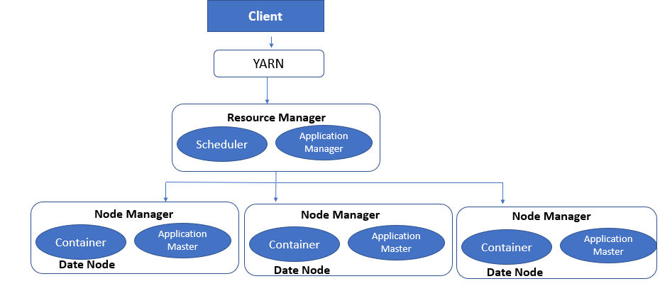
YARN Architecture

Slide 3
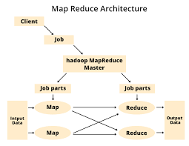

Slide 4
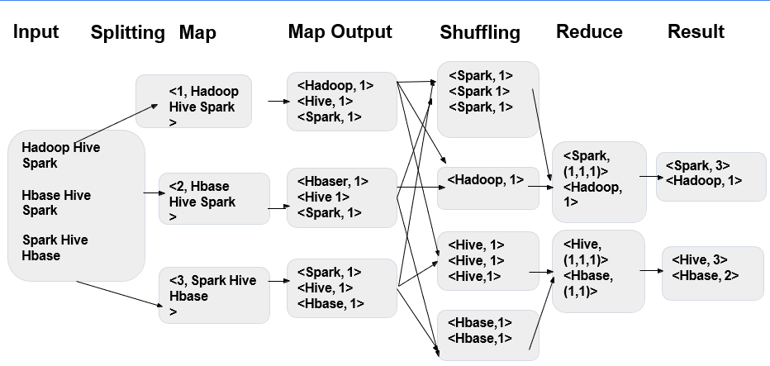
Hadoop Map Reduce – Word Count sample

Slide 5
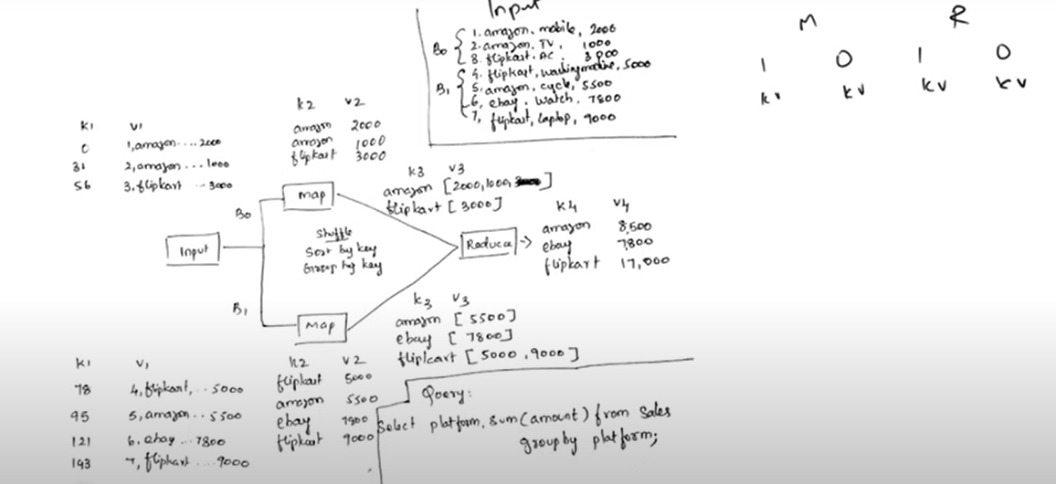
Hadoop Map Reduce – Query sample

Slide 6
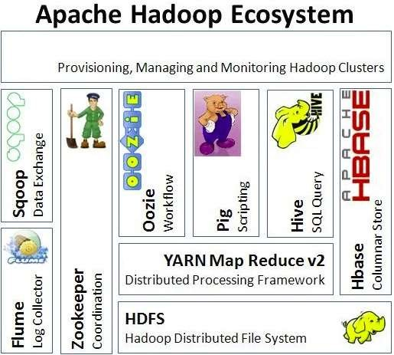

Slide 7
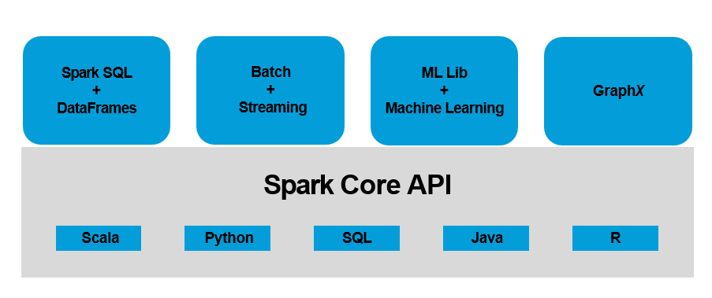
Spark Eco system

Slide 8
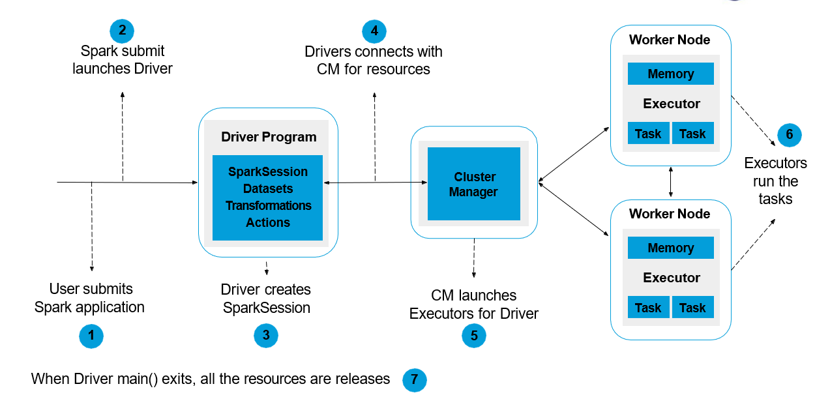
Spark Life cycle Application

Slide 9
Feature | Hadoop 2 | Hadoop 3
Resource Management | Introduced YARN for resource management, allowing multiple applications to share cluster resources. | Improved YARN with Opportunistic Containers and Distributed Scheduling for better resource utilization.
Storage Efficiency | Data stored with a replication factor (default is 3). | Introduced Erasure Coding for reduced storage overhead, requiring less disk space than replication.
Scaling | Supports scaling up to thousands of nodes but has limitations in large-scale deployments. | Improved scalability, with better resource management and distributed scheduling, supporting even larger clusters
HDFS (Hadoop Distributed File System) | Single NameNode; provided High Availability (HA) by allowing a standby NameNode. | Supports Multiple NameNodes (Federation), improving scalability and fault tolerance.
MapReduce | Traditional MapReduce framework; supports batch processing. | Improved support for different processing models, including enhancements in MapReduce.
Minimum Java Version | ava 6 or Java 7. | Requires Java 8 as the minimum version.

